Slide 1
Graph Based Machine Learning
Arnie Horta

Slide 2
Graphs in machine learning
Lots of applications combine graphs with other ideas
Used Analysis of email text leveraging to-from links
Graph-based ontologies used aid in NLP tasks
Internet graphs with features for cyber defense
How do you leverage the graph structure to aid in the other tasks given that the data is of a different form
We will discuss two ideas
Graph embedding using Node2Vec
Graph Convolutional Neural Networks

Slide 3
Node2Vec
Based on Word2Vec embedding algorithm
Takes each node in the graph and creates a vector
Nearby vectors convey near nodes or nodes with structural similarities
One can then use these vectors together with other features in another machine learning task

Slide 4
Word2Vec
Embedding of words that capture nearby words in a corpus.
Given a word create a shallow neural network to predict context words.
Example: “The dog barking was loud”. Assume barking is the target word.
Data input into network is (barking, the), (barking, dog), (barking, was), (barking, loud).
Represent using one-hot encoding.

Slide 5
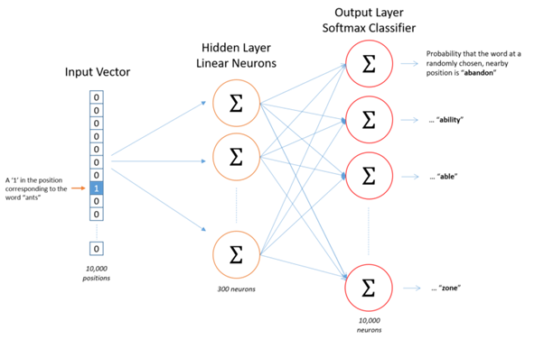
Word2Vec

Slide 6
Node2Vec
Leverage Word2Vec
For each node in the graph, take random walks to determine the the “context nodes”
Create data like the Word2Vec data to feed into the neural network
Example from https://towardsdatascience.com/node2vec-explained-graphically-749e49b7eb6b

Slide 7
Random walk

Slide 8
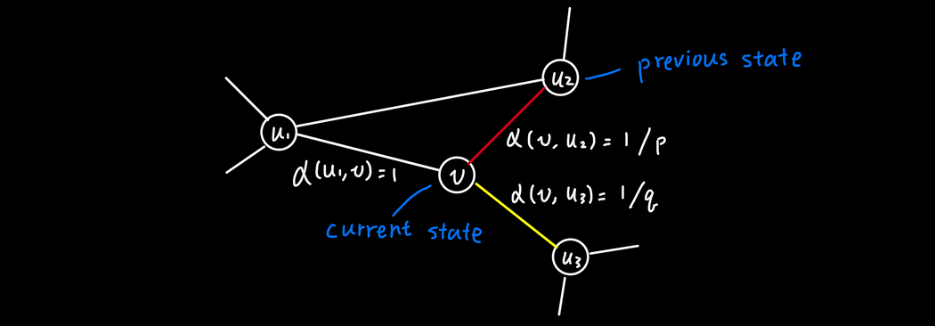
Introducing bias

Slide 9
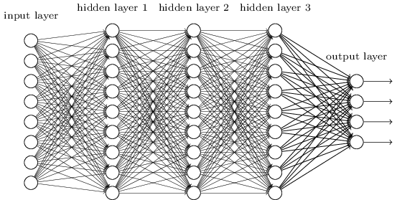
Regular Convolutional Neural Networks

Slide 10
Regular Convolutional Neural Networks

Slide 11
The issue with Graphs
Convolution requires that patch of the same size that you can “move” across the entire image
For graphs, each node can have a different number of nodes adjacent to it.
The easy solution: for each node take a random walk of fixed length and include a fixed number of nodes
More complex solution: resort to fourier analysis on graphs using the graph Laplacian
This replaces the convolution step in a CNN

